Slide 1
Math Vocabulary
Numbers and Operations M05.A-T dividing whole numbers
Aligning with
Pennsylvania Department of Education
Core Assessment Anchors
and enVision Math Textbook Topic 4 and Topic 5
©2011-2016 Caryn Dingman
www.mrsdingman.com

Slide 2




dividend
* a number you divide
* tells how many in all
dividend
©2011-2016 Caryn Dingman www.mrsdingman.com
enVision Topic 4 & Topic 5
PA Assessment Anchor MO5.A-T

Slide 3



divisor
* a number used to divide another number
divisor
©2011-2016 Caryn Dingman www.mrsdingman.com
enVision Topic 4 & Topic 5
PA Assessment Anchor MO5.A-T

Slide 4




quotient
* answer to a division problem
quotient
quotient
©2011-2016 Caryn Dingman www.mrsdingman.com
enVision Topic 4 & Topic 5
PA Assessment Anchor MO5.A-T

Slide 5
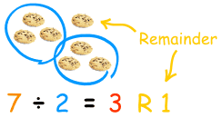
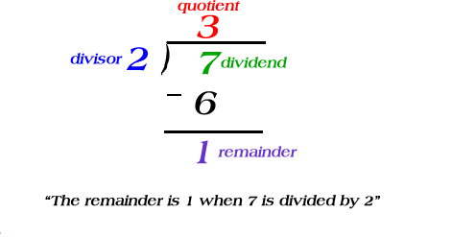
remainder
* a number that may be left after division problem is complete
©2011-2016 Caryn Dingman www.mrsdingman.com
enVision Topic 4 & Topic 5
PA Assessment Anchor MO5.A-T

Slide 6
interpret the remainder
* deciding what to do with a number that may be left after division problem is complete
3 choices:
1.) Drop it: drop the remainder- do not use it
2.) Round it: round the quotient to the next highest whole number
3.) Share it: use the remainder to make a fraction
©2011-2016 Caryn Dingman www.mrsdingman.com
enVision Topic 4 & Topic 5
PA Assessment Anchor MO5.A-T

Slide 7
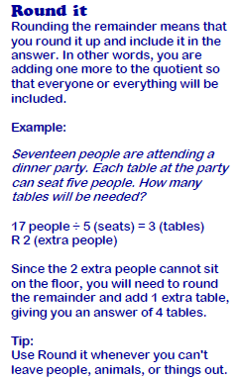
Round It Example:
interpret the remainder
©2011-2016 Caryn Dingman www.mrsdingman.com
enVision Topic 4 & Topic 5
PA Assessment Anchor MO5.A-T

Slide 8
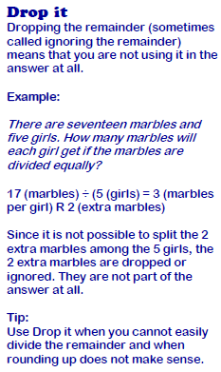
Drop It Example:
interpret the remainder
©2011-2016 Caryn Dingman www.mrsdingman.com
enVision Topic 4 & Topic 5
PA Assessment Anchor MO5.A-T

Slide 9
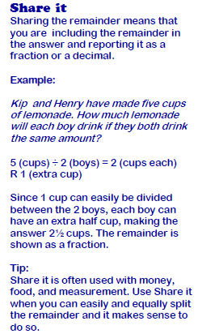
Share It Example:
interpret the remainder
©2011-2016 Caryn Dingman www.mrsdingman.com
enVision Topic 4 & Topic 5
PA Assessment Anchor MO5.A-T

Slide 10
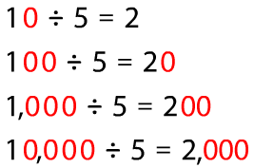

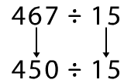

patterns to divide
* find the whole number fact you know
©2011-2016 Caryn Dingman www.mrsdingman.com
enVision Topic 4 & Topic 5
PA Assessment Anchor MO5.A-T

